Slide 1
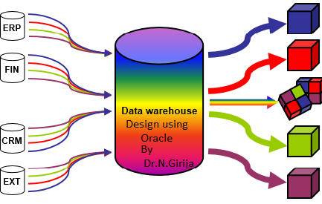
Data warehouse Design Using Oracle
https://www.oercommons.org/authoring/21861-data-warehouse-design-using-oracle
OER UNIT 3 - OLAP

Slide 2
DIMENSIONAL MODELING
A data cube allows data to be modeled and viewed in multiple dimensions.
The data cubes are n-dimensional.
In the data warehouse, an n-D base cube is called a Base Cuboid which holds the lowest level of summarization. The base cuboid for the given lattices is time, item, location, and supplier dimensions.
The top most 0-D cubiod is called a apex Cuboid which holds the highest-level of summarization is called apex cuboid. For example total sales or dollars sold, Summarized for all four dimensions. The apex cuboid is typically denoted by all.
The lattice (i.e. network) of cuboids forms a data cube

Slide 3
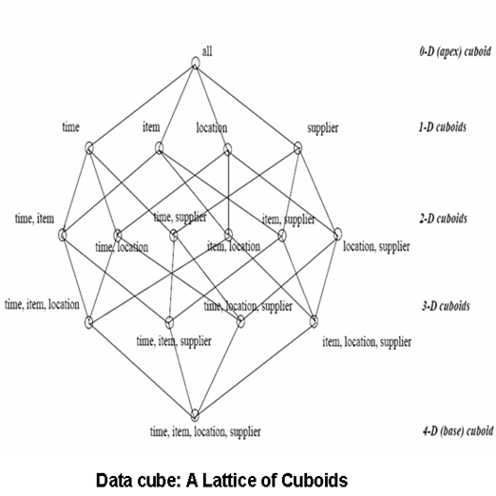

Slide 4
Location_key | Product_key | Time_key | Vechicle_sold
1 | 1 | 1 | 2
1 | 1 | 2 | 4
1 | 1 | 3 | 6
1 | 1 | 4 | 8
1 | 2 | 1 | 10
1 | 2 | 2 | 12
1 | 2 | 3 | 14
1 | 2 | 4 | 16
1 | 3 | 1 | 18
1 | 3 | 2 | 20
1 | 3 | 3 | 22
1 | 3 | 4 | 24
1 | 4 | 1 | 26
1 | 4 | 2 | 28
1 | 4 | 3 | 30
1 | 4 | 4 | 32
2 | 1 | 1 | 1
2 | 1 | 2 | 2
2 | 1 | 3 | 3
2 | 1 | 4 | 4
2 | 2 | 1 | 5
2 | 2 | 2 | 6
2 | 2 | 3 | 7
2 | 2 | 4 | 8
2 | 3 | 1 | 9
2 | 3 | 2 | 10
2 | 3 | 3 | 11
2 | 3 | 4 | 12
2 | 4 | 1 | 13
2 | 4 | 2 | 14
2 | 4 | 3 | 15
2 | 4 | 4 | 16

Slide 5
Location_key | Product_key | Time_key | Vechicle_sold
3 | 1 | 2 | 6
3 | 1 | 3 | 9
3 | 1 | 4 | 12
3 | 2 | 1 | 15
3 | 2 | 2 | 18
3 | 2 | 3 | 21
3 | 2 | 4 | 24
3 | 3 | 1 | 27
3 | 3 | 2 | 30
3 | 3 | 3 | 33
3 | 3 | 4 | 36
3 | 4 | 1 | 39
3 | 4 | 2 | 42
3 | 4 | 3 | 45
3 | 4 | 4 | 48
4 | 1 | 1 | 4
4 | 1 | 2 | 8
4 | 1 | 3 | 12
4 | 1 | 4 | 16
4 | 2 | 1 | 20
4 | 2 | 2 | 24
4 | 2 | 3 | 28
4 | 2 | 4 | 32
4 | 3 | 1 | 36
4 | 3 | 2 | 40
4 | 3 | 3 | 44
4 | 3 | 4 | 48
4 | 4 | 1 | 52
4 | 4 | 2 | 56
4 | 4 | 3 | 60
4 | 4 | 4 | 64

Slide 6
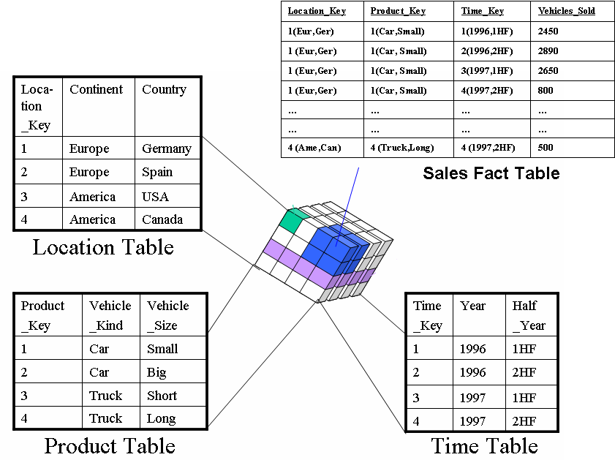

Slide 7
PART 1 – SLICE OPERATION

Slide 8
Location_key | Product_key | Time_key | Vechicle_sold
1 | 1 | 1 | 2
1 | 1 | 2 | 4
1 | 1 | 3 | 6
1 | 1 | 4 | 8
1 | 2 | 1 | 10
1 | 2 | 2 | 12
1 | 2 | 3 | 14
1 | 2 | 4 | 16
1 | 3 | 1 | 18
1 | 3 | 2 | 20
1 | 3 | 3 | 22
1 | 3 | 4 | 24
1 | 4 | 1 | 26
1 | 4 | 2 | 28
1 | 4 | 3 | 30
1 | 4 | 4 | 32

Slide 10
The slice operation performs a selection on one dimension of the given cube, resulting in a sub cube.
The slice operator retrieves a subset of a data cube similar to the restriction operator of relational algebra.
Query:
Write a statement to display how many vehicles sold in location Germany.
SELECT location_key, sum(Vechicle_sold) from Sales_Fact where(location_key =1) group by location_key;
LOCATION_KEY SUM(VECHICLE_SOLD)
----------------------------------------------------------
1 272
OUTPUT EXPLANATION
The 272 value is sum of ((1,1,1), (1,1,2), (1,1,3), (1,1,4), (1,2,1), (1,2,2), (1,2,3), (1,2,4), (1,3,1), (1,3,2), (1,3,3), (1,3,4), (1,4,1), (1,4,2), (1,4,3), (1,4,4))
Total Number of Rows is 16
Sum of Rows are from 1.1.1, 1.1.2….1.4.4

Slide 11
PART 2 – DICE OPERATION

Slide 12
The dice operation defines a sub cube by performing a selection on two or more dimensions.
In other words, by specifying value ranges on one or more dimensions, the user can highlight meaningful blocks of aggregated data.
The dice operation is a slice on more than two dimensions of a data cube (or more than two consecutive slices
SQL> SELECT location_key, sum(Vechicle_sold) from Sales_Fact where(location_key =1) and (product_key=1) group by location_key;
OUTPUT
LOCATION_KEY SUM(VECHICLE_SOLD)
------------ ------------------
1 20

Slide 14
PART 3 – DRILL DOWN

Slide 15
2,4,6,8

Slide 16
Drill-down is the reverse of rollup
Drill-down function allows users to obtain a more detailed view of a given dimension
SQL> SELECT location_key, Vechicle_sold from Sales_Fact where(location_key =1) and (product_key=1);
OUTPUT
LOCATION_KEY VECHICLE_SOLD
------------ -----------------------------------
1 2
1 4
1 6
1 8
OUTPUT EXPLANATION
The values are from (1,1,1),(1,1,2),(1,1,3),(1,1,4)

Slide 17
PART 4 – ROLLUP

Slide 18
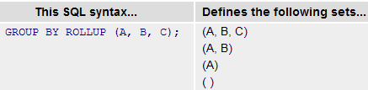
ROLLUP operation used to show result set of totals and subtotals.
It adds subtotal rows into the result sets of queries with GROUP BY clauses.
ROLLUP generates a result set showing aggregates for a hierarchy of values in the selected columns.
Every ROLLUP operation returns a result set with one row where NULL appears, NULL row represents the summary of each column to the aggregate function.

Slide 19
select location_key,product_key, time_key, sum(vechicle_sold) from sales_fact where (location_key=1 and product_key=1) group by rollup (location_key, product_key, time_key);
LOCATION_KEY PRODUCT_KEY TIME_KEY SUM(VECHICLE_SOLD)
--------------------------------------------------------------------------------------------------------
1 1 1 2
1 1 2 4
1 1 3 6
1 1 4 8
1 1 20
1 20
20
(A,B,C)
Drill Down
(A,B) Dice
(A) Slice

Slide 20
PART 5 – CUBE

Slide 21
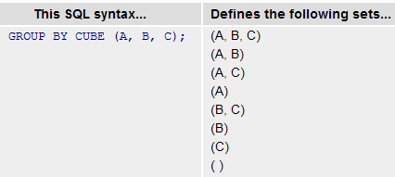
select location_key,product_key, time_key, sum(vechicle_sold) from sales_fact where (location_key=1 and product_key=1) group by cube (location_key,product_key,time_key);

Slide 22
Like ROLLUP, the CUBE operator provides subtotals of aggregate values in the result set.
Unlike ROLLUP, When the CUBE operation is performed on variables, the result set includes many subtotal rows based on combinations of the values of the variables.
The CUBE operator returns a result set with added information of dimensions to the data.
CUBE provides a cross tabulation report of all possible combinations of the dimensions and generates a result set that shows aggregates for all combinations of values in selected columns.
All CUBE operations return result sets with at least one row where NULL appears in each column except for the aggregate column

Slide 23
LOCATION_KEY PRODUCT_KEY TIME_KEY SUM(VECHICLE_SOLD)
------------ ----------- ---------- ------------------
20
1 2
2 4
3 6
4 8
1 20
1 1 2
1 2 4
1 3 6
1 4 8
1 20
()
( C )
(B)
(B,C)
(A)
1 1 2
1 2 4
1 3 6
1 4 8
1 1 20
1 1 1 2
1 1 2 4
1 1 3 6
1 1 4 8
20 rows selected.
(A,C)
(A,B)
(A,B,C)

Slide 24
PART 6 – GROUPING SETS

Slide 25
GROUPING SETS compute groups on several different sets of grouping columns in the same query.
Whereas CUBE and ROLLUP add a predefined set of subtotals into the result set, GROUPING SETS explicitly specify which subtotals to add.
select location_key,product_key, time_key, sum(vechicle_sold) from sales_fact where (location_key=1 and product_key=1) group by grouping sets (location_key,product_key,time_key);
LOCATION_KEY PRODUCT_KEY TIME_KEY SUM(VECHICLE_SOLD)
------------ ----------- ---------- ------------------
1 20
1 20
1 2
2 4
3 6
4 8

Slide 26
PART 7 – PIVOT

Slide 27
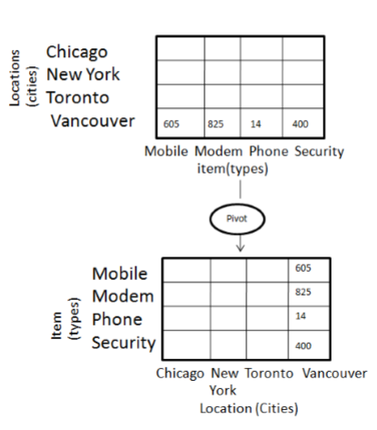
The pivot operator supports rearrangement of the dimensions in a data cube.
The pivot is a simple but effective operation that allows OLAP users to visualize cube values in more natural and intuitive ways.
This visualization operation that rotates the data axes in view in order proceeds of to provide an alternative presentation of the data.
The pivot operation is also known as rotation. It rotates the data axes in view in order to provide an alternative presentation of data.
Great new feature called PIVOT for presenting any query in the crosstab format using a new operator, appropriately named pivot.

Slide 28
A Pivot query can be written as follows:
A column or expression that will display in the pivot table.
SELECT * FROM
(
SELECT column1, column2
FROM tables
WHERE conditions
)
PIVOT
(aggregate_function(column2)
FOR (column2)
IN ( expr1, expr2, ... expr_n) | subquery
)
ORDER BY expression [ ASC | DESC ];
The column or expression that will be used with the aggregate_function SUM, MAX,MIN, COUNT…
The column that contains the pivot values
To specify multiple possible values for a pivot column values, it is also heading of the Query result

Slide 29
Parameters or Arguments
Aggregate_function
It can be a function such as SUM, COUNT, MIN, MAX, or AVG functions.
IN ( expr1, expr2, ... expr_n )
A list of values for column2 to pivot into headings in the cross-tabulation query results.
subquery
It can be used instead of a list of values. In this case, the results of the subquery would be used to determine the values for column2 to pivot into headings in the cross-tabulation query results.

Slide 30
Breaks PIVOT CLAUSE
Specify Fields to Include
Specify Aggregate Function
Specify Pivot Values
Need to specify what pivot values to include in the results
specify what fields to include in the cross tabulation
Aggregate such as SUM, COUNT, MIN, MAX, or AVG functions
FOR (product_code) IN ('A' AS a, 'B' AS b, 'C' AS c));
SELECT product_code, quantity FROM pivot_test
PIVOT
(SUM(quantity) AS sum_quantity

Slide 31
INSERT INTO pivot_test VALUES (1, 1, 'A', 10);
INSERT INTO pivot_test VALUES (2, 1, 'B', 20);
INSERT INTO pivot_test VALUES (3, 1, 'C', 30);
INSERT INTO pivot_test VALUES (4, 2, 'A', 40);
INSERT INTO pivot_test VALUES (5, 2, 'C', 50);
INSERT INTO pivot_test VALUES (6, 3, 'A', 60);
INSERT INTO pivot_test VALUES (7, 3, 'B', 70);
INSERT INTO pivot_test VALUES (8, 3, 'C', 80);
INSERT INTO pivot_test VALUES (9, 3, 'D', 90);
INSERT INTO pivot_test VALUES (10, 4, 'A', 100);
COMMIT;
CREATE TABLE pivot_test (
id NUMBER,
customer_id NUMBER,
product_code VARCHAR2(5),
quantity NUMBER
);

Slide 32
In its basic form the PIVOT operator is quite limited.
We are forced to list the required values to PIVOT using the IN clause.
SELECT * FROM
(SELECT product_code, quantity FROM pivot_test)
PIVOT
(SUM(quantity) AS sum_quantity FOR (product_code) IN ('A' AS a, 'B' AS b, 'C' AS c));

Slide 33
If we want to break it down by customer, we simply include the CUSTOMER_ID column in the initial select list.
SELECT *
FROM (SELECT customer_id, product_code, quantity FROM pivot_test)
PIVOT
(SUM(quantity) AS sum_quantity FOR (product_code) IN ('A' AS a, 'B' AS b, 'C' AS c))
ORDER BY customer_id;

Slide 34
PIVOT EXERCISE 1
CREATE TABLE orders
( order_id number(6) primary key,
customer_ref varchar2(25) NOT NULL,
product_id number,
ORDER_DATE DATE,
quantity number
);
insert into orders values(1,'MALIK',10,'20-NOV-2017',100);
insert into orders values(2,'MALIK',20,'23-NOV-2017',20);
insert into orders values(3,'SALIM',10,'01-DEC-2017',5);
insert into orders values(4,'SALIM',20,'30-DEC-2017',4);
insert into orders values(5,'SALIM',30,'04-JAN-2018',5);
insert into orders values(6,'MALIK',30,'04-JAN-2018',6);
insert into orders values(7,'ZULFA',10,'23-NOV-2017',15);
insert into orders values(8,'ZULFA',20,'01-DEC-2017',12);
insert into orders values(9,'ZULFA',10,'01-DEC-2017',6);

Slide 35
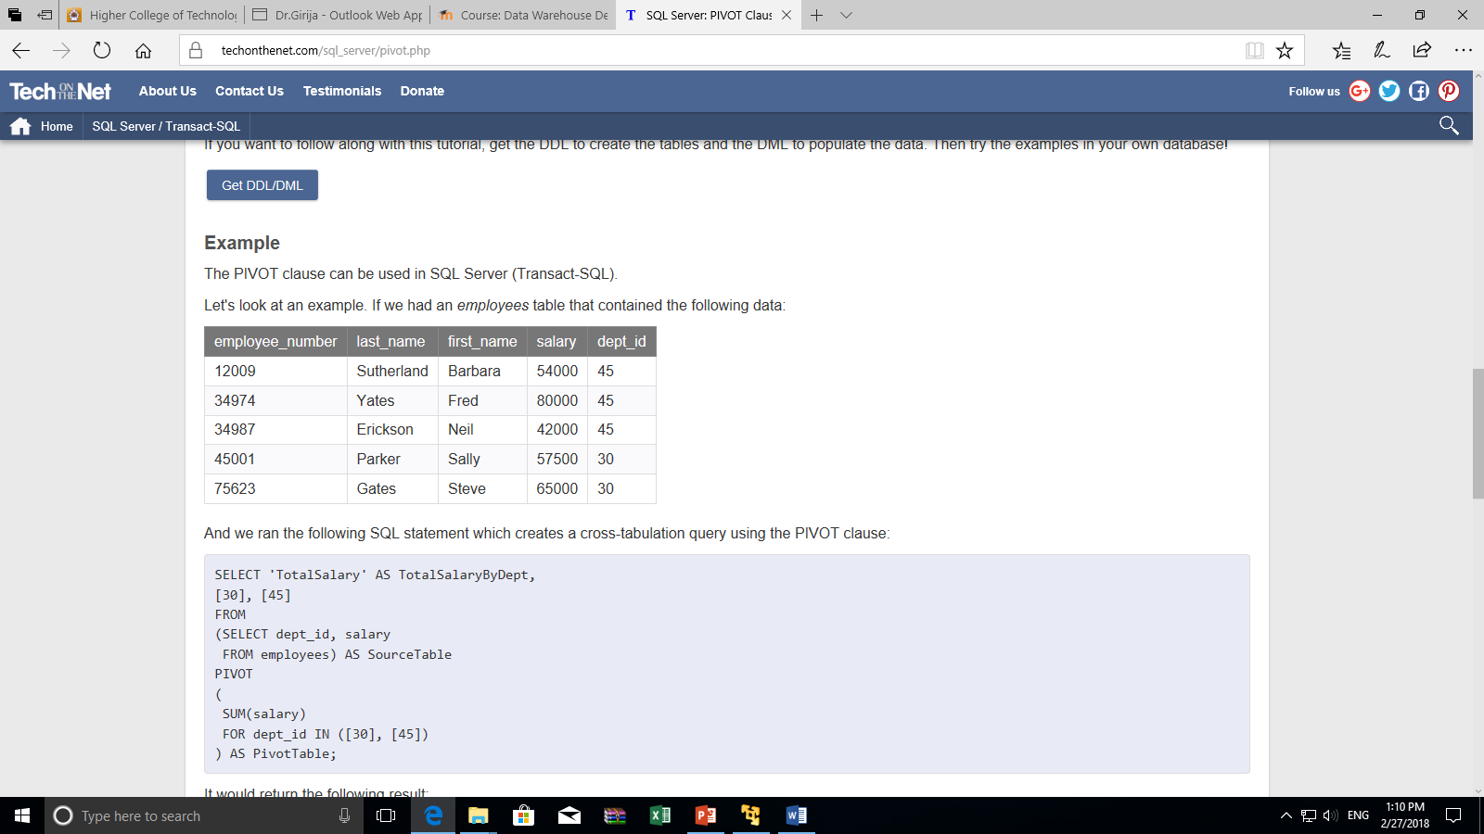

Write a Pivot statement to display how many times the customer purchased the same product. The product is categorized based on product_id.
Exercise 2:
Create emp_salary table with following values:
create a pivot table to display the total salary for dept_id 30 and dept_id 45, the result should be display like this

Slide 36
EXERCISE

Slide 37
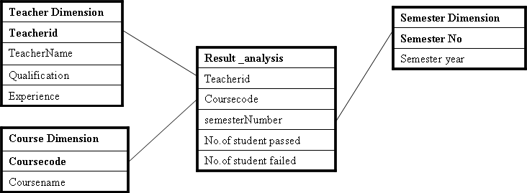

Slide 38
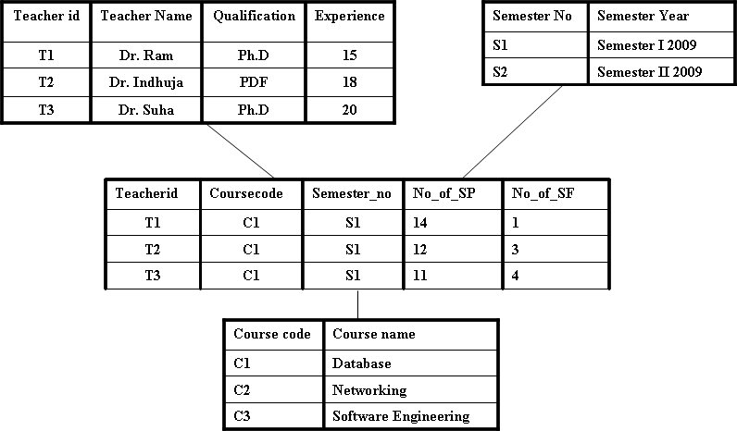

Slide 39
Teacherid | Coursecode | Semester_no | No_of_SP | No_of_SF
T1 | C1 | S1 | 14 | 1
T2 | C1 | S1 | 12 | 3
T3 | C1 | S1 | 11 | 4
T1 | C2 | S1 | 10 | 5
T2 | C2 | S1 | 8 | 7
T3 | C2 | S1 | 9 | 6
T1 | C3 | S1 | 11 | 4
T2 | C3 | S1 | 9 | 6
T3 | C3 | S1 | 10 | 5
T1 | C1 | S2 | 10 | 5
T2 | C1 | S2 | 7 | 8
T3 | C1 | S2 | 8 | 7
T1 | C2 | S2 | 6 | 9
T2 | C2 | S2 | 5 | 10
T3 | C2 | S2 | 4 | 11
T1 | C3 | S2 | 13 | 2
T2 | C3 | S2 | 11 | 4
T3 | C3 | S2 | 10 | 5

Slide 40
1) Write an appropriate SQL statement of total number of student passed in semester one in the entire course taken by all three teachers.
2) Write an appropriate SQL statement of total number of student passed in semester two in the entire course taken by all three teachers
3) Write an appropriate SQL statement total number of student Failed in semester one in the entire course taken by all three teachers.
4) Write an appropriate SQL statement of total number of student Failed in semester two in the entire course taken by all three teachers.
5) Write an appropriate SQL statement to display semester number, course code, number of student failed in semester two in course code C1.
6) Write an appropriate SQL statement to display teacher id, course code, total number of student passed in course code c1 and teacher id T1.
7) Write an appropriate SQL statement to display teacher id, course code, number of student passed in semester S1 and teacher id is T1.
Write an appropriate SQL statement using ROLLUP operation to display semester number, teacher id, course code, total number of student passed only for semester number S1
Write an appropriate SQL statement using CUBE operation to display semester number, teacher id, course code, total number of student failed only for semester number S2.
Write an appropriate SQL statement using Grouping Sets operation to display semester number, teacher id, course code, total number of student passed only for Teacher number T1

